Slide 1
FINAL DELIVERABE
DVA 0610 TEAM 4
Team Member | Email
Sanjana Banerjee | mail4sanjanabanerjee@gmail.com
Vishnu Ayinipully | vishnuayinipully725@gmail.com
Asma Batool | asma.batoolahmad@gmail.com
Harini B | harinimiffy11@gmail.com
Sandra Banda | sandrabanda552@gmail.com
Asish Bag | bagasish1@gmail.com

Slide 2

------------------------------------------------------
OBJECTIVE
------------------------------------------------------
To ensure the accuracy, consistency, and completeness of campaign data through systematic cleaning, SQL-based validation, and visual analysis — enabling reliable insights for performance evaluation and strategic decision-making.
Looker Studio Dashboard Link : https://lookerstudio.google.com/reporting/c22df009-d5db-4cc5-b998-438a31cf38b4

Slide 3
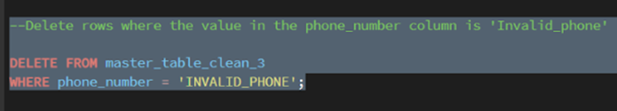
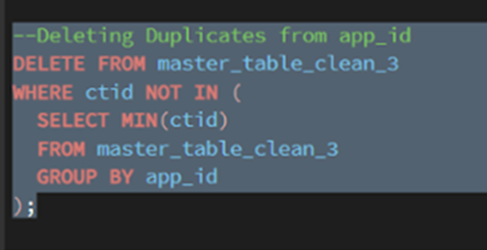
--------------------------------------------------------
DATA CLEANING – SQL SCRIPT
--------------------------------------------------------
Deleting Invalid Phone numbers from our joined master table
Deleting duplicate data entries from our column app_id.

Slide 4
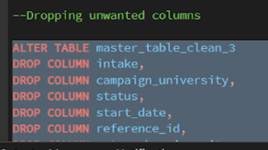
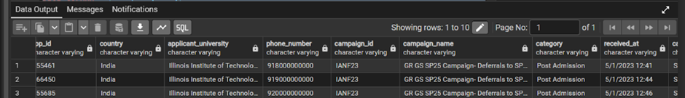
--------------------------------------------------------
DATA CLEANING – SQL SCRIPT
--------------------------------------------------------
Dropping the unwanted columns like:
1-intake: because it was unnecessary data not needed for our immediate analysis.
2-Campaign university: because it has same data as outreach university and applicant university
3-Status: because it was same status which was completed for all.
4-Start date: because there were only 4 start dates with most of them same.
5-Reference: if because it was same as applicant id.

Slide 5
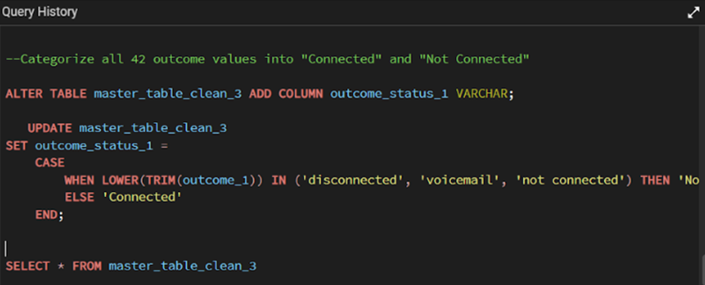
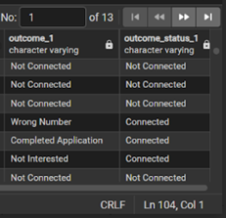
--------------------------------------------------------
DATA CLEANING – SQL SCRIPT
--------------------------------------------------------
Categorizing similar outcomes in connected and disconnected columns

Slide 6
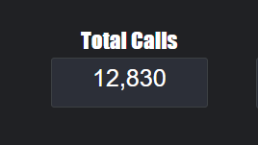
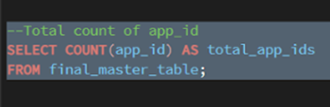
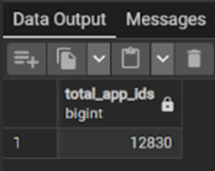
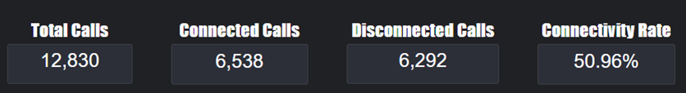
--------------------------------------------------------
DATA CLEANING – SQL SCRIPT & LOOKER STUDIO DATA VALIDATION
--------------------------------------------------------
FINAL VALIDATION OF OUR POSTGRE MASTER TABLE
LOOKER STUDIO
Initial uploaded Data
Score Cards on looker studio.
1- Total Calls – Connected Calls + Disconnected Calls
2- Connectivity Rate – Connected Calls / Total Calls x 100
Rows dropped from 37,881 to 12,830 after cleaning and standardizing the dataset. Duplicate applicant records were removed to maintain one entry per app_id. Invalid or unreachable phone numbers and incomplete call records were excluded. Additionally, redundant and identifier-missing rows were dropped to ensure data accuracy and readiness for analysis.

Slide 7
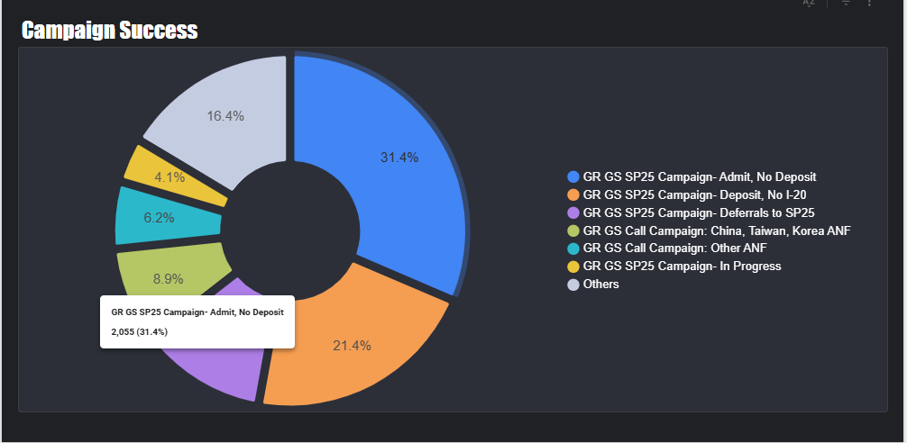
--------------------------------------------------------
DATA ANALYSIS WITH LOOKER STUDIO -
Campaign Success Overview
--------------------------------------------------------
Campaign name VS Number of connected calls
* The largest segment (31.4%) includes students who were admitted but have not yet deposited.
* This indicates interest is high, but financial or clarity concerns remain.
* 21.4% deposited but are awaiting processing, meaning strong trust exists.
* Students deferring admissions (16.4%) show interest but face timing or personal delays.
* Follow-up efforts are crucial to convert admitted students into fee-paying enrolled students.

Slide 8
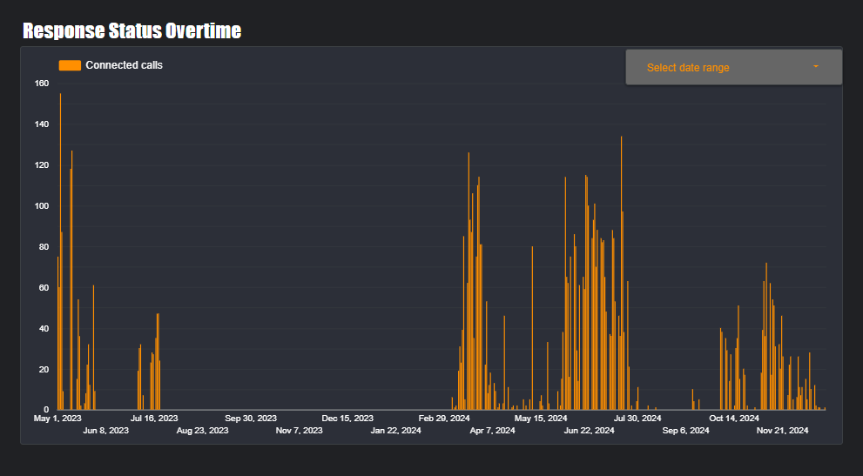
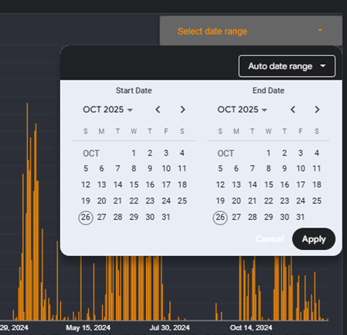
--------------------------------------------------------
DATA ANALYSIS WITH LOOKER STUDIO -
Response Status Overtime
--------------------------------------------------------
- Peaks in call connections occurred during May–July and November.
- These periods align with active admission cycles where students are making decisions.
- Low engagement months (Aug–Sep & Jan–Feb) coincide with exam and holiday periods.
- Calling during these key decision windows significantly improves engagement

Slide 9
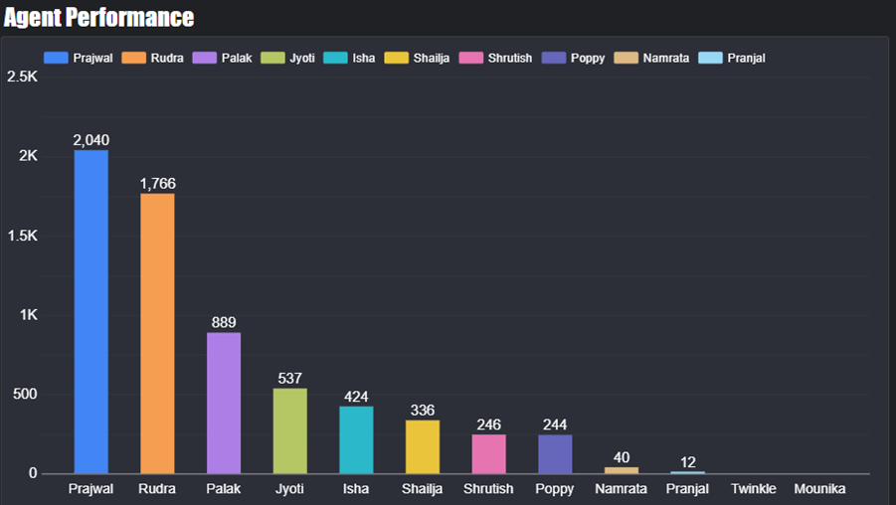
--------------------------------------------------------
DATA ANALYSIS WITH LOOKER STUDIO -
Agent Performance
--------------------------------------------------------
The success rate of agent based on connected calls :
- Prajwal and Rudra lead strongly with 2040 and 1766 successful calls.
- Their performance suggests effective call timing, tone, and consistent follow-ups.
- Mid-level performers show potential but may require guidance on call strategies.
- Lower engagement levels suggest reduced availability, lack of follow-ups, or timing issues

Slide 10
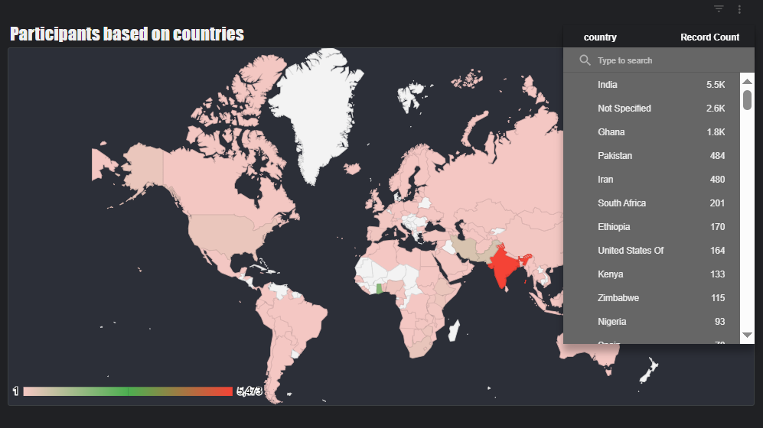
--------------------------------------------------------
DATA ANALYSIS WITH LOOKER STUDIO -
Participants Record
--------------------------------------------------------
Country Based Performance - This map shows the areas results according to number of active participants from all over the globe .

Slide 11
------------------------------------------------------------
DATA INSIGHT - What Makes Top Agents Successful?
------------------------------------------------------------
They call during peak availability hours (10 AM–1 PM & 4 PM–7 PM).
They consistently follow up instead of relying on single attempts.
Key Recommendations
- Prioritize follow-up calls for admitted but unpaid students.
- Share call scripts and strategies used by top-performing agents.
- Increase calling frequency during high-response time windows.
- Provide transparent guidance regarding enrollment procedures.

Slide 12
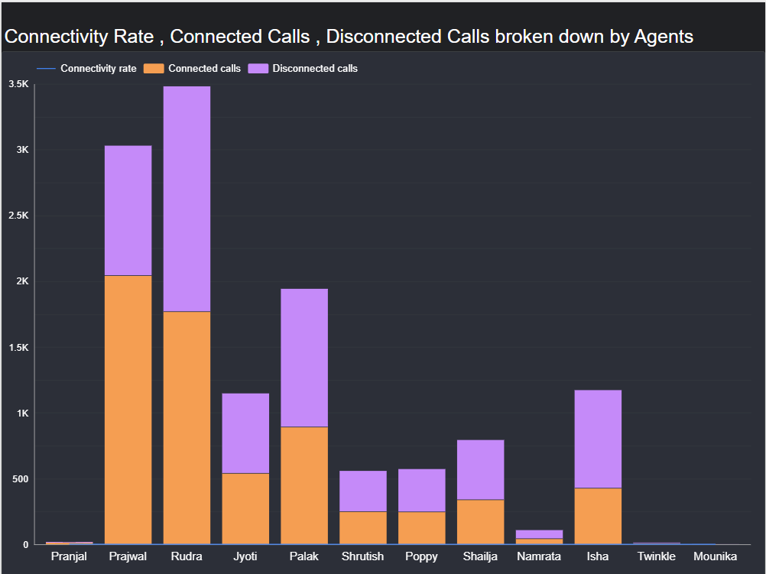
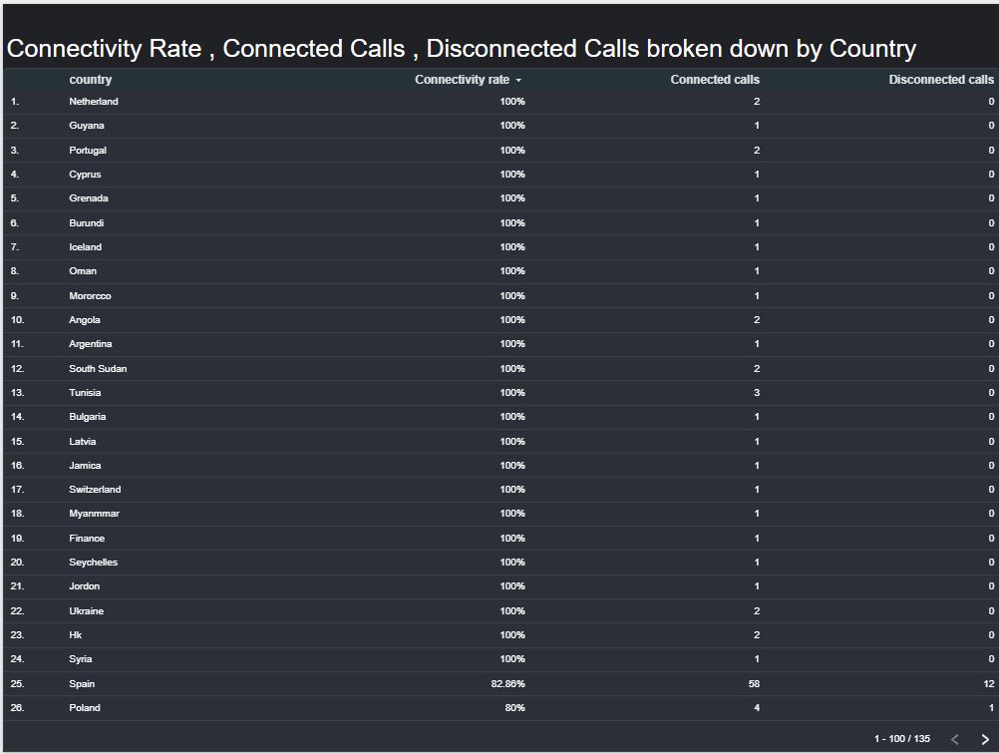
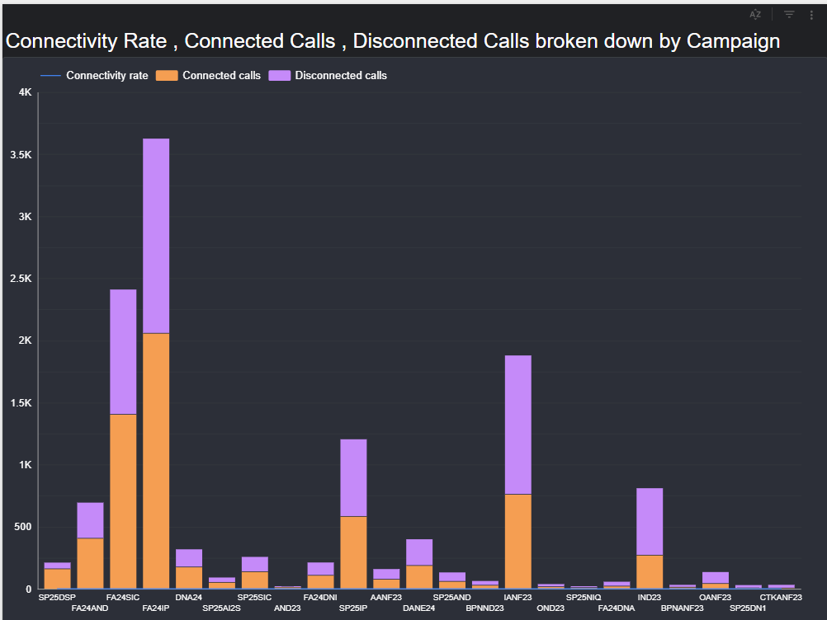

Slide 13
--------------------------------------------------------
DATA VALIDATION REPORT
--------------------------------------------------------
Validation Type | Check Performed | Issue Found | Action Taken
Duplicate Records | Checked duplicates in app_id | Duplicates found and removed | Kept only unique app_id
Missing Values | Checked missing in key columns | Few missing countries | Excluded or labeled as "Unknown"
Business Rule Alignment | Connected calls + Disconnected calls = Total calls | All records consistent | No issue
Column Redundancy | Checked redundant columns | Found 4 redundant | Merged and removed unnecessary columns
Intake/Status Uniformity | All same values | Confirmed constant | Removed columns

Slide 14
THANK YOU

